Slide 1
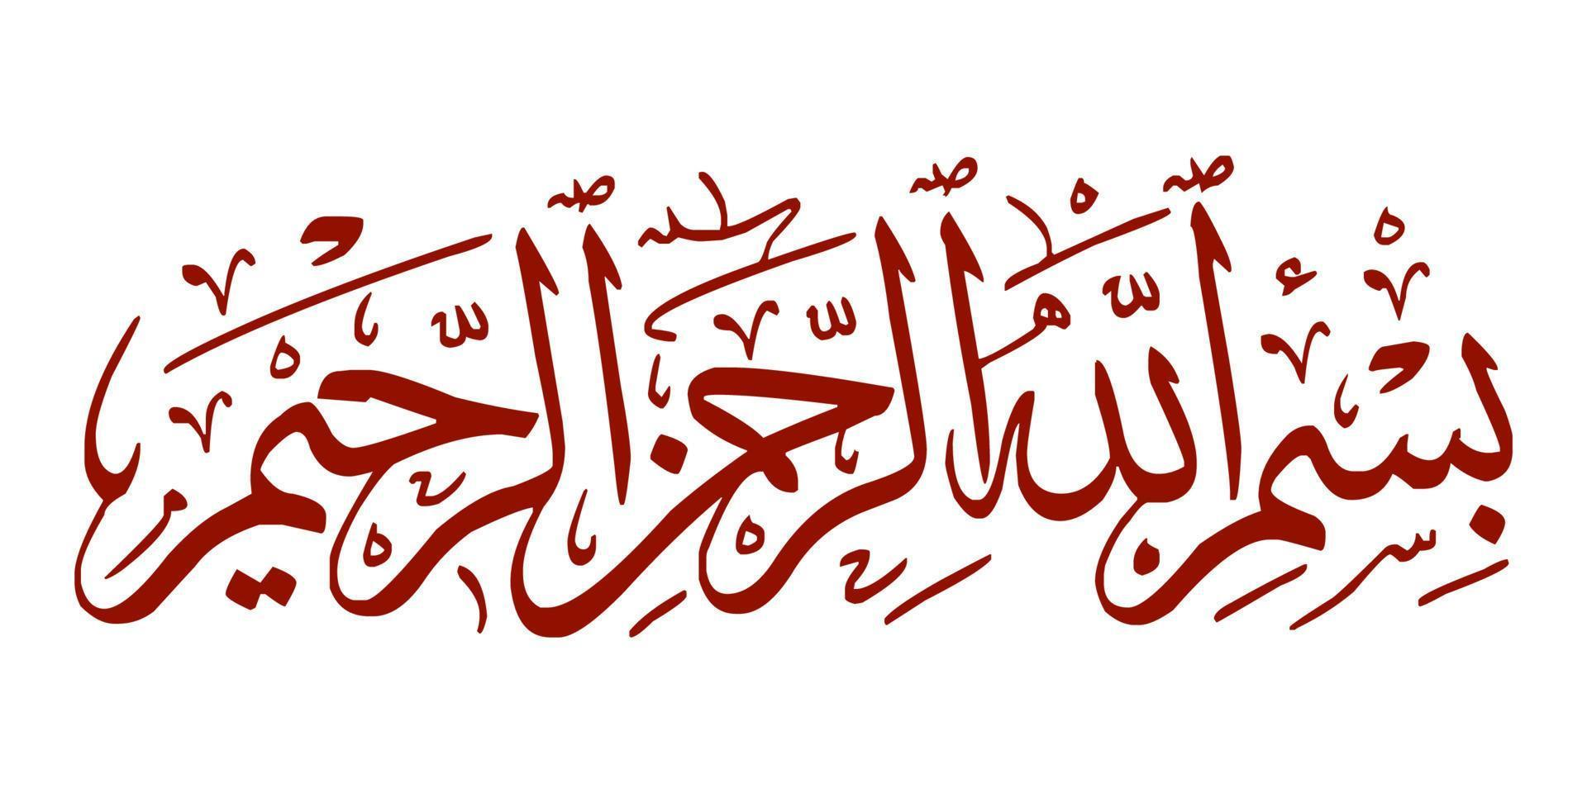

Slide 2

Introduction of the Course
Religion
SS-1002
Islamic & Religious Studies
School of Computing
National University of Computer and Emerging Sciences
Deen & Madhab
Sobia Shehzadi
sobia.shehzadi.v@nu.edu.pk

Slide 3
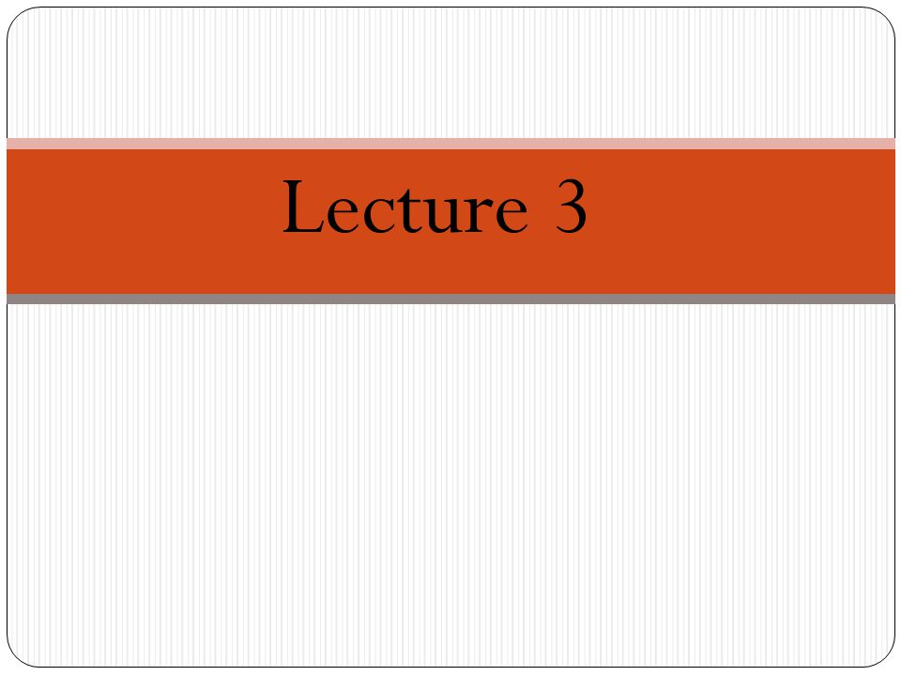

Slide 4

Literal Meaning of Islam
Terminological Meaning of Islam
Islam and Eman
Literal Meaning of Eman
Terminological Meaning of Eman
Difference between Islam & Eman

Slide 5
Literal Meaning of Islam
The word Islam is derived from (س، ل، م) سَلَمَ or سَلِمَ, يَسْلَمُ سَلَامًا وسَلَامَة, which means to avoid, to reconcile , to be safe, to find and provide peace and security and well-being.
According to this literal meaning, it is said in the hadith of the Prophet:
الْمُسْلِمُ مَنْ سَلِمَ الْمُسْلِمُوْنَ منْ لِّسَانِه وَيَدِه
“A Muslim is the one from whose tongue and hands the Muslims are safe”

Slide 6
According to the dictionary, the word “Islam” implies four meanings:
To find peace and security
Allah said in the Holy Qur'an:
يَهْدِيْ بِهِ اﷲُ مَنِ اتَّبَعَ رِضْوَانَه سُبُلَ السَّلٰمِ.
“Through which Allah guides those who seek His pleasure to the ways of peace”
2. To accept, to submit, to bow down and to accept submission and obedience.
In the Holy Qur'an, Allah Ta'ala said:
اِذْ قَالَ لَه رَبُّه اَسْلِمْ قَالَ اَسْلَمْتُ لِرَبِّ الْعٰلَمِيْنَo
“When his Lord said to him, “Surrender,” he promptly responded, “I have surrendered to the Lord of the Universe (and become a Muslim).”

Slide 7
3. Peace and harmony
يٰاَيُّهَا الَّذِيْنَ اٰمَنُوا ادْخُلُوْا فِی السِّلْمِ کَآفَّةً.
“O believers! Enter into Islam wholeheartedly ”
4. A tall tree is also called Al-Salam in the Arabic dictionary.

Slide 8
Terminological meaning
The meaning of Islam is to surrender, while in the term, the name of surrendering oneself to the Shariat of Muhammad (peace and blessings of Allah be upon him) is Islam.
Islam is a religion which itself is complete security and teaches peace and security, love and tolerance, moderation and balance and patience to others.

Slide 9
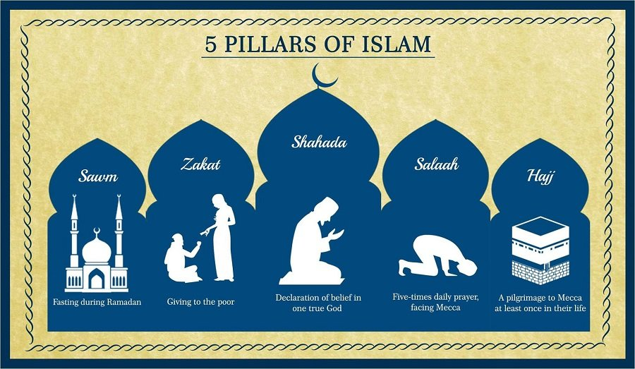

Slide 10


Slide 11
Literal meaning of Eman
Eman is an Arabic word. It is derived from ’’ا۔ م۔ ن‘‘ (امن,peace).
According to the dictionary, to be safe from any fear, to be satisfied with the heart and to cope with the well-being of a person is called peace.
When the word Eman is used as an imperative verb, it means "to have peace", and when it is used as a transitive verb, it means "to give peace".
So ,the word Eman in its original meaning indicates peace, trust and confidence.

Slide 12
Terminological Meaning
The word “Eman" has appeared more or less forty-five (45) times in the Holy Qur'an.
Eman is the name of the sure state of the heart and inner being, in which the heart and inner body are empty of the love of the world and filled with the love of Allah.
Eman are the subject of faiths or عقائد .

Slide 13
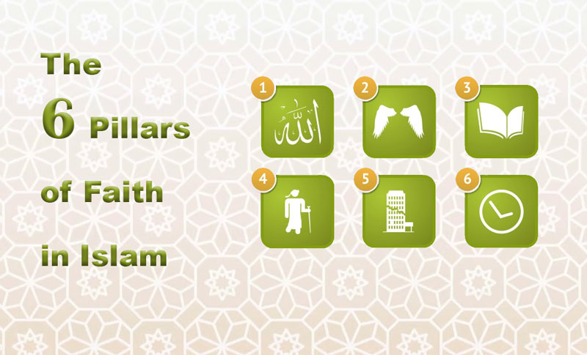

Slide 14

Difference between “Islam” and “Eman”
Eman and Islam are actually two sides of one reality

Slide 15
Important Note
There is a rational and logical connection between the religion of Islam and Eman in such a way that anyone who is a believer and a person of Eman will certainly be a Muslim, but a person who is only a Muslim is not necessarily a believer and a person of Eman.

Slide 16
introduction
Explanation
Muslim Belifs

Slide 17
Introduction
The imams and muhadditheen have explained faith and faith from the Qur'an and Hadith in a very beautiful way to explain its teachings in a simple and easy way. Islamic scholars have described the attributes of faith in two ways:
1. Eman-e-Mujamal
2. Eman-e-Mufassal
In Eman-e-Mujamal, faith is explained in a very short but comprehensive way because the meaning of Mujamal is "summary". In it, believing in Allah has been mentioned in such a way that all faiths come into it without declaring it.
While in Eman-e-Mufassal, the proven beliefs in the light of Quran and Hadith have been explained in detail.

Slide 18

IMAN-E- MUJMAL (The Summary Declaration of Faith)
“I solemnly believe in ALLAH with His all Names and personal Attributes and I also accept all His commandments by reciting them with tongue and believing them with hear.”
IMAN-E- MUFASSIL (The Detailed Declaration of Faith)
“I have faith in Allah and His Angels, His Books and His Messengers, and the Day of Judgment and that all good and evil and fate is from Almighty Allah and it is sure that there will be resurrection after death.”

Slide 19
Explanation
Believing in the oneness and uniqueness of Allah.
Believing in all prophets of ALLAH..
A true Muslim follows the Prophet Muhammad (peace be upon him) in his doings.
Believing in all Holy books and all angles .
Believing in his life after death. He will be raised from the grave on the Day of Judgments.
The good Muslim will be reward and go the paradise forever.
The wicked person will be punished and go to hell forever.

Slide 20
Towheed, Literal Meaning
Terminological Meaning
The concept of Towheed (توحید)
Types of Towheed
Effect of Towheed on Human life
Effect of Towheed on Collective life

Slide 21
Literal Meaning of Towheed
The word Towhid is derived from وحد Its substance is و، ح،د ,its literal meanings are
To believe alone,
To declare oneness,
To be alone and one.

Slide 22
Terminological Meaning
In the terminology of Shari'ah, it is Towhid to hold the belief
"Allah Ta'ala is unique in His essence, attributes and all Traits and perfections, He has no partner or fellow, no one equal to Him.“
Muhammad Iqbal Keilani writes in his book "Kitab al-Towhid":
“On the Day of Resurrection, in the presence of Aqeedah Towhid, the shortcomings of actions and slips can be forgiven. But in the case of distortion of belief, disbelief, polytheism righteous deeds equal to the expanses of the earth and sky will be useless and futile.”

Slide 23
Quranic Verse
إِنَّ الَّذِينَ كَفَرُواْ وَمَاتُواْ وَهُمْ كُفَّارٌ فَلَن يُقْبَلَ مِنْ أَحَدِهِم مِّلْءُ الأرْضِ ذَهَبًا وَلَوِ افْتَدَى بِهِ أُوْلَئِكَ لَهُمْ عَذَابٌ أَلِيمٌ وَمَا لَهُم مِّن نَّاصِرِينَ
بے شک جو لوگ کافر ہوئے اور کفر کی حالت میں مر گئے تو کسی ایسے سے زمین بھر کر سونا بھی قبول نہیں کیا جائے گا اگرچہ وہ اس قدر سونا بدلے میں دے، ان لوگوں کے لیے دردناک عذاب ہے اور ان کا کوئی مددگار نہیں ہوگا۔
“Indeed those who turn faithless and die while they are faithless, a world of gold will not be accepted from any of them should he offer it for ransom. For such there will be a painful punishment, and they will have no helpers.”

Slide 24
Hadith
Blessed is the saying of the Messenger of Allah (P.B.U.H)
الإِيمَانُ بِضْعٌ وَسَبْعُونَ أَوْ بِضْعٌ وَسِتُّونَ شُعْبَةً فَأَفْضَلُهَا قَوْلُ لاَ إِلَهَ إِلاَّ اللَّهُ
“There are more than 70 branches of Eman, the best of them is to say لا إله إلا الله “
So, the basis of Eman is the word Tawheed.

Slide 25
Hadith
There is a hadith narrated from the Messenger of Allah (peace and blessings of Allah be upon him) regarding the virtue of monotheis
مَنْ شَهِدَ أَنْ لاَ إِلَهَ إِلاَّ اللَّهُ وَحْدَهُ لاَ شَرِيكَ لَهُ ، وَأَنَّ مُحَمَّدًا عَبْدُهُ وَرَسُولُهُ ، وَأَنَّ عِيسَى عَبْدُ اللَّهِ، وَالْجَنَّةُ حَقٌّ وَالنَّارُ حَقٌّ ، أَدْخَلَهُ اللَّهُ الْجَنَّةَ عَلَى مَا كَانَ مِنَ الْعَمَلِ
“If anyone testifies that there is no god but God alone, who has no partner, that Muhammad is His servant and messenger, that Jesus is God's servant and messenger, and that paradise and hell are real, God will cause him to enter paradise no matter what he has done.”

Slide 26
Types of Towheed
Towhid-ul-Rububiyyat( توحید ربوبیت )(Oneness of Allah’s Lordship)
Towhid al-Ibadat (توحيد العبادة) (Oneness of Worship)
Towhid-ul-Asma’ wal-Sifat (توحید اسماء وصفات)(Oneness of Allah’s Names and Attributes).

Slide 27

The Effects of Monotheism(توحید) on Human Life
Faith has profound effects on human life.

Slide 28

Effects of Monotheism (توحید) on Communal Life
Due to Aqeedah Towhid, there are positive effects at the social level as well

Slide 29

حدیث جبرائیل
The Hadith of Jibreel (Gabriel)

Slide 30
What is Islam?
What is Eman?
What is Ehsan?
What are the signs of The Hour (Doomsday)?

